Slide 1

TEAM MEMBERS:​ 1. HIMABALA -CB.SC.U4AIE24028​ 2. NIKHIL -CB.SC.U4AIE24063​ 3. SANDEEP -CB.SC.U4AIE24047​ 4. CHAITHANYA -CB.SC.U4AIE24040
Electrical Motor Fault Detection Using IoT

Slide 2
Contents Slide:
Introduction - (3 to 4 slides)
Literature Review - (5 to 6 slides)
Research Gaps - (7th slide)
Problem Statement - (8th slide)
Objectives - (9th slide)
Block Diagram / Flowchart - ( 10th slide)
Methodology - (11th slide)
Results and Discussion - (12th slide)
Conclusions & Future Scope - (13th slide)
References - (14th slide)
2

Slide 3
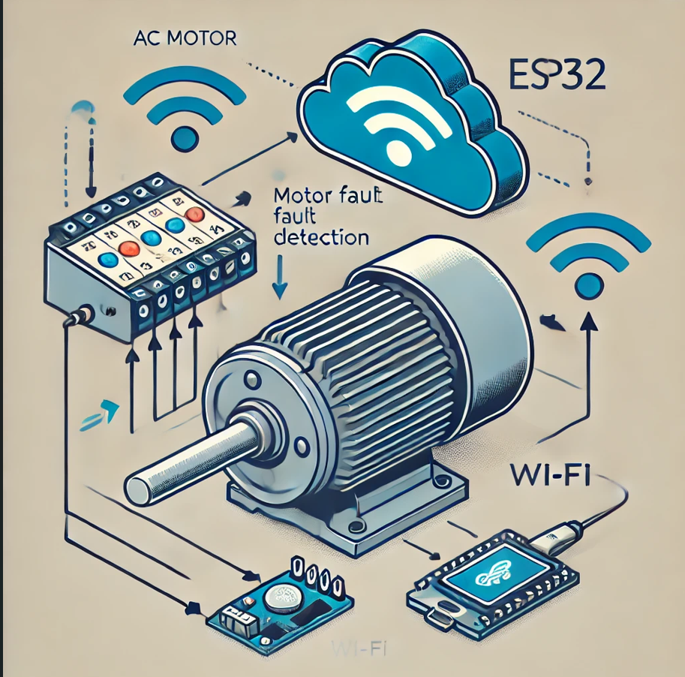
INTRODUCTION TO IOT IN MOTORS
The Internet of Things (IoT) is revolutionizing various industries, including the motor industry. By integrating IoT technology into motors, we can achieve real-time monitoring, predictive maintenance, and enhanced efficiency​.
What is IoT in Motors?
in motors involves embedded sensors, software, and connectivity into motors to collect and exchange data. This data can be used to monitor IoT performance ,detect faults, and optimize operations.
For Example:motor fault detection project, IoT plays a key role in real-time monitoring and alerting. Here’s how:
✅ Step 1: Data Collection – The vibration sensor attached to the motor detects abnormal vibrations.
✅ Step 2: Processing & Transmission – The ESP32 processes the vibration data and transmits it to the cloud using Wi-Fi.
✅ Step 3: Remote Monitoring & Alerts – The collected data is displayed on an LCD screen and sent to an IoT platform (like Blynk or Thingspeak). If an issue is detected, the system sends an alert to the user via a mobile app. In your motor fault detection project, IoT plays a key role in real-time monitoring and alerting. Here’s how:
3

Slide 4
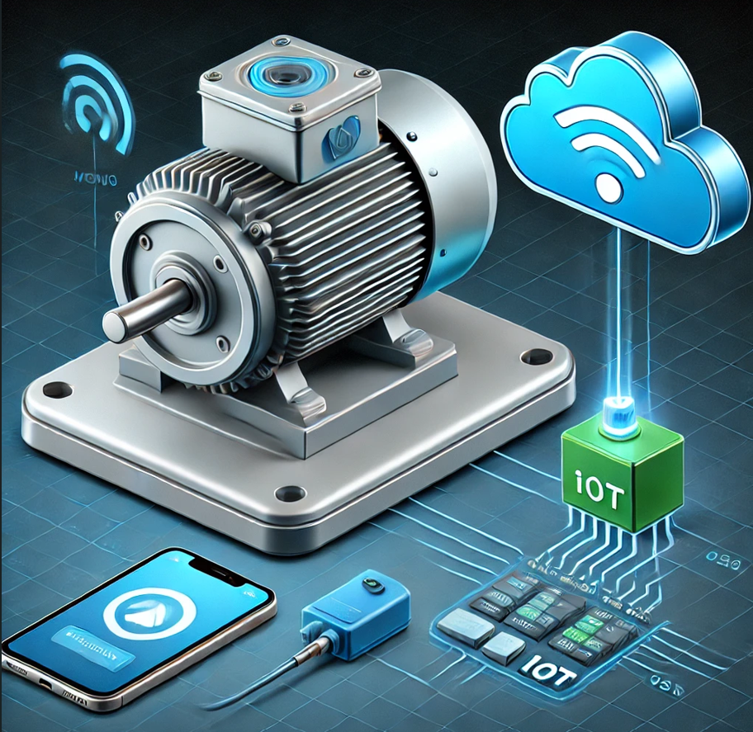
Importance of Fault Detection in Electrical Motors:
Prevents Unexpected Failures – Catching faults early helps avoid sudden breakdowns, keeping operations running smoothly without costly interruptions.
Reduces Maintenance Costs – Regular monitoring helps identify minor issues before they turn into expensive repairs, saving both time and money.
Ensures Worker Safety – Faulty motors can overheat or malfunction, posing safety risks. Early detection minimizes hazards and creates a safer work environment.
Increases Motor Lifespan & Efficiency – When motors run with undetected faults, they work harder than necessary, leading to higher energy consumption and wear. Proper monitoring extends their lifespan and improves performance.
Supports Smart Automation & Remote Monitoring – With IoT-based systems, motors can be monitored in real time, reducing the need for manual checks and making industrial processes more efficient.
4

Slide 5
LITERATURE REVIEW:
Sl.no | Year | Title | Purpose | Methodology | Key findings | Relevance to Current Research
1. | 2023 | IoT-Based Motor Fault Detection System | Develop a system for real-time monitoring of motor performance using IoT sensors. | Experiment with IoT sensors | The system effectively detects anomalies with a high accuracy rate. | Supports the integration of IoT for efficient monitoring.
2. | 2022 | Predictive Maintenance Using IoT in Electric Motors | Explore predictive maintenance strategies using IoT. | Data analytics and modelling. | Predictive algorithms can significantly reduce unexpected failures. | Highlights the value of predictive maintenance approaches.
3. | 2021 | Smart Motor Fault Detection Framework | Propose a framework for diagnosing motor faults with IoT. | Framework development | Proposed framework demonstrates faster diagnosis times compared to traditional methods. | Provides a baseline for developing real-time diagnostic tools.
5

Slide 6
Sl.no | Year | Title | Purpose | Methodology | Key findings | Relevance to Current Research
4. | 2020 | Real-Time Monitoring of Motor Performance | Investigate a real-time monitoring system for industrial motors using IoT | IoT sensor networks | Implemented system showed noticeable improvements in fault detection time. | Emphasizes the importance of real-time data in fault detection
5. | 2019 | Machine Learning for Fault Detection in Motors | Examine the application of machine learning techniques in motor fault detection. | Machine learning algorithms | Machine learning models improve fault detection accuracy over traditional methods | Suggests incorporation of machine learning in IoT systems.
6

Slide 7
Research Gaps:
These are the most important reasons for addressing research gaps:
Real-World Application: Validating theoretical studies in practical environments ensures that IoT solutions are effective under real-world conditions, maximizing their utility.
A need for low-cost, vibration-based motor fault detection systems.
Real-time data analysis and predictive maintenance capabilities are lacking in some existing solutions.
Many current methods rely on multiple sensors, increasing both cost and complexity.
7

Slide 8
Problem Statement:
Industrial motors often fail unexpectedly, causing operational disruptions and high repair expenses. There is a need for an affordable, real-time IoT-based vibration monitoring system to detect faults early and prevent such issues.
Industrial motors often face mechanical failures, leading to unplanned maintenance and production halts
Early fault detection can help prevent these failures, but existing solutions are either expensive or inefficient.
Affordable Solutions: Current monitoring systems can be expensive, highlighting the need for more cost-effective options.
8

Slide 9
Block Diagram:
Components: Vibration Sensor → ESP32 → Cloud (Blynk) → LCD Display → Mobile Alerts
+------------------+ +------------------+ +-----------------+
| AC Motor | ----> | Vibration Sensor | ----> | ESP32 |
+------------------+ +------------------+ +-----------------+
| |
v v
+------------------+ +----------------------+
| LCD Display | | Cloud Platform (Blynk) |
+------------------+ +----------------------+
|
v
+----------------------+
| Mobile Alerts (App) |
+----------------------+
10

Slide 10
Objectives:
To develop an IoT-based system for real-time motor fault detection.
We use a vibration sensor to monitor motor health and detect faults.
To integrate ESP32 with cloud-based monitoring for live data visualization.
To provide instant alerts via the Blynk app when abnormal vibrations are detected.
To implement predictive maintenance strategies to extend motor lifespan and reduce costs.
To Assess Energy Efficiency.
9

Slide 11
Methodology :
✅ 1. Detecting Motor Faults:
A vibration sensor is attached to the motor to continuously monitor the movements.
If the motor starts shaking abnormally due to misalignment, wear, or imbalance, the sensor captures the fault.
Example: If a fan inside the motor becomes loose, the vibration sensor detects the unusual movement.
✅ 2. Sending Data to the Cloud:
The ESP32 microcontroller collects the vibration data and sends it to an IoT platform like Blynk.
The system analyzes patterns to check if the motor is running normally or showing signs of failure.
Example: If the motor’s vibrations cross a safe limit, the system marks it as a potential fault.
✅ 3. Alerting & Displaying Results:
The LCD screen shows real-time vibration values.
If a fault is detected, an alert is sent to the user via a mobile app, allowing quick action.
Example: If a machine in a factory is vibrating too much, an operator gets an alert on their phone to check it before failure occurs.
11

Slide 12
Results & Discussion Slide:
Graph showing normal vs. faulty motor vibration patterns.
Observations: Increased vibration levels indicate potential faults, demonstrating the effectiveness of the system.
The system successfully identifies motor faults before critical failure, allowing timely intervention.
Comparison with Traditional Methods: The IoT-based approach offers lower costs, real-time alerts, and remote monitoring, unlike traditional manual checks.
12

Slide 13
Conclusions & Future Scope Slide:
✅ Conclusion: The IoT-based vibration monitoring system proves to be an efficient and low-cost solution for detecting motor faults, reducing downtime, and ensuring better maintenance planning.
🚀 Future Scope:
Implementing AI-driven analytics to predict future failures based on vibration trends.
Adding temperature and current sensors for a more comprehensive monitoring system.
Developing automated repair scheduling using predictive maintenance insights.
Exploring low-power IoT solutions to improve system energy efficiency.
13

Slide 14
References Slide (IEEE Format):

